Slide 1
Community Wellbeing Toolkit
Feeling Safe,
Taking Care of Yourself, and Getting Support.

Slide 2
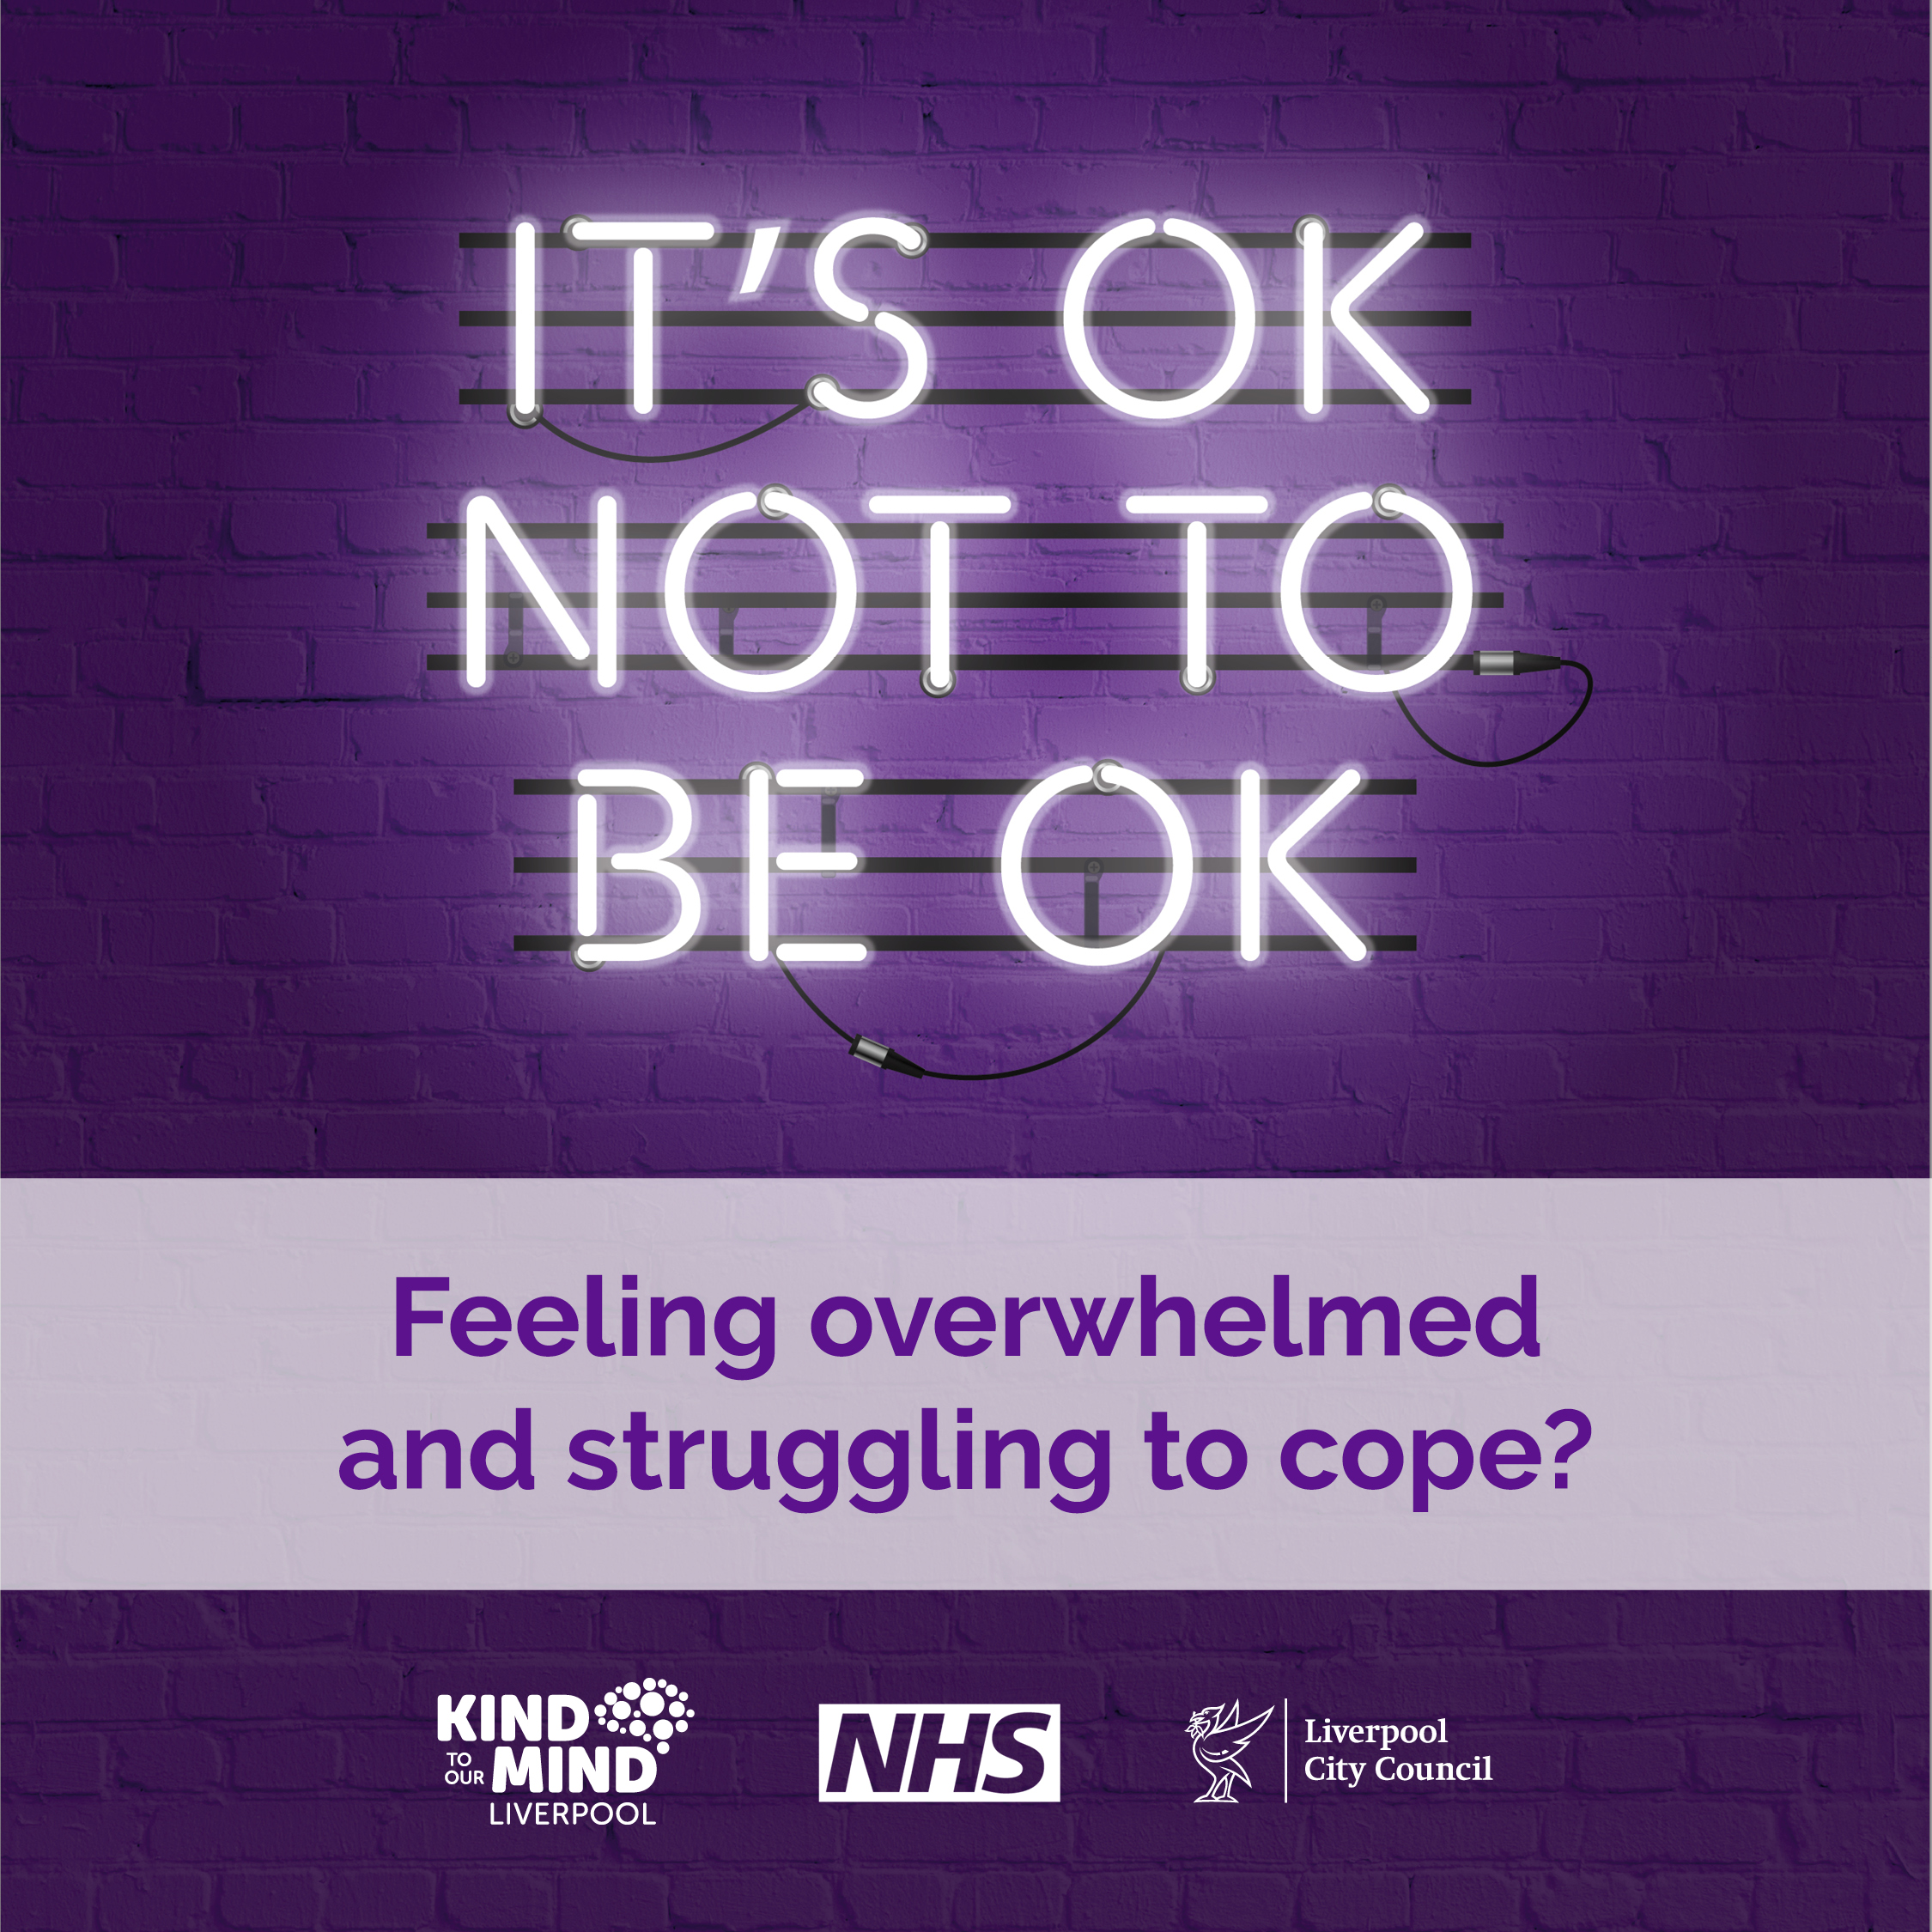
Difficult or Traumatic Events
Everyone reacts differently to tough or traumatic experiences. Seeing or hearing about conflict or violence can be really upsetting, and for some, it can be pretty overwhelming.
After something really upsetting happens, you might experience:
Bad dreams, flashbacks, or thoughts you can’t shake.
Strong emotions like worry, fear, anger, guilt, or shame.
Negative thoughts about yourself or others, like blaming yourself.
Acting differently, maybe avoiding going out or not enjoying things you used to.
Changes in how you connect with others, like feeling distant or on guard.
These feelings and symptoms are often temporary but sometimes they persist and impact mental health. It’s important to remember, help is out there if you need it.

Slide 3
Ways to start feeling better
Give yourself time…
Friends, family, or anyone you trust can help you feel better. Being around people who care about you helps you feel protected and supported.
Stick to your routine…
Keep doing your usual activities, even if it feels tough. It can help bring some normality back into your life.
Talking to someone you trust about what happened and how you’re feeling can be a big relief. It might even help them too if they’re going through something similar. Listening to how someone feels can make a big difference.
Lean on your support around you…
Overcoming these thoughts and feelings can take time, so don’t put yourself under too much pressure to feel better straight away.
Talk about it…
They can offer emotional support, help with practical tasks or just spending time doing normal things - all help improve our mood.
Take care of yourself
Eating well, staying active, and getting enough sleep are all part of self-care and are essential to mental health and wellbeing.

Slide 4
When to get help
Everyone heals differently, and many people recover with support from those around them.
But if you notice that you or someone you know isn’t getting better, here are some signs that more help might be needed:
Feeling the same or worse over time?
If you’ve been feeling really bad for more than a few weeks and it’s not getting better, it might be time to reach out for help.
Feeling down all the time?
If you’re feeling sad or anxious most days, or if you’re having trouble sleeping or thinking clearly, it’s okay to ask for help.
Lost interest in things?
If you’re not into the things you usually enjoy, consider reaching out for support.
Feeling overwhelmed?
If you ever feel like you just can’t handle things, it’s important to get some help as soon as possible.

Slide 5
How can you help someone?
If you’re worried about someone, here’s how you can support them:
Be there – offer to spend time and let them know you’re there for them, even if they’re not ready to talk.
Listen – if they do want to talk, just listen. You don’t have to give advice—just being there and hearing them out can mean a lot.
Ask how you can help – ask if they need help finding extra support or with practical things like chores or running errands.
Ask the hard questions - if you’re really worried, don’t be afraid to ask if they’re self-harming or thinking about suicide.
It’s important to know so you can help them get the right support.
Visit Reach Out Liverpool for more.

Slide 6
We're here for you, if you need to talk to someone...
If you live in Wirral, the below services offer immediate support for children and young people with their emotional wellbeing and mental health. These services are available 24/7.
Urgent Mental Health support for children, young people and adults, open 24/7.
CALL 111 and select option 2 for mental health support
Shout 85258 is a free, confidential, 24/7 text message support service for anyone who feels overwhelmed or is struggling to cope. The service is staffed by trained volunteers, and they can help with issues such as stress, anxiety, and depression any time of day or night. TEXT ‘SHOUT’ to 8525
Kooth provide safe, anonymous online support for young people aged 10-25.
Visit Kooth.com

Slide 7
We're here for you, if you need to talk to someone...
Not sure where to go for further mental wellbeing support?
Branch is here to help you find the best mental wellbeing support for children and young people in Wirral, 0 -18 years old (up to 25 with additional needs). It’s packed with tips and gives simple routes into the best local and national services for their mental wellbeing needs. www.branch-wirral.co.uk
The Drop In. They do not operate a crisis service, but you can visit them for support. No appointment needed. Open to ages 11-18 years old. The Drop In is open Monday-Friday 2-6pm at Pilgrim Street, CH41 5EH. https://www.zillowirral.co.uk/the-drop-in
Family Hubs. Looking for wider family support? Family Hubs bring together a range of services for families and children. Simply pop into your local hub. https://familytoolbox.co.uk/resource-list/family-hubs/

